Slide 1
Wereldwijd toegepast.

Slide 2


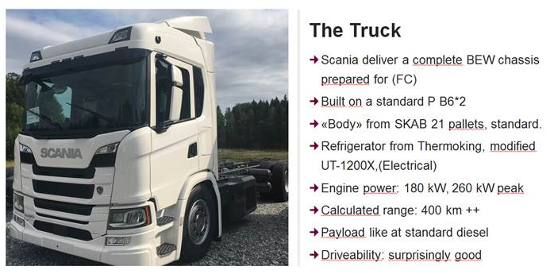






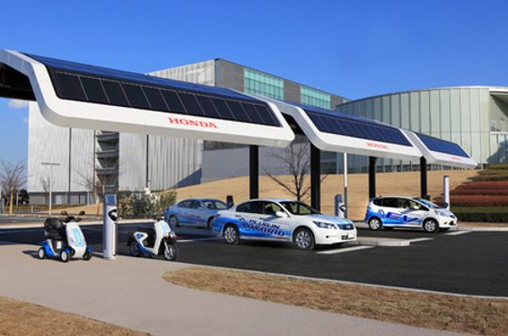














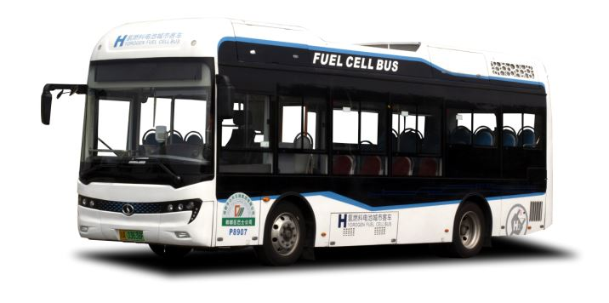








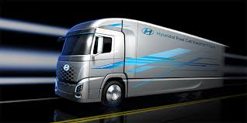




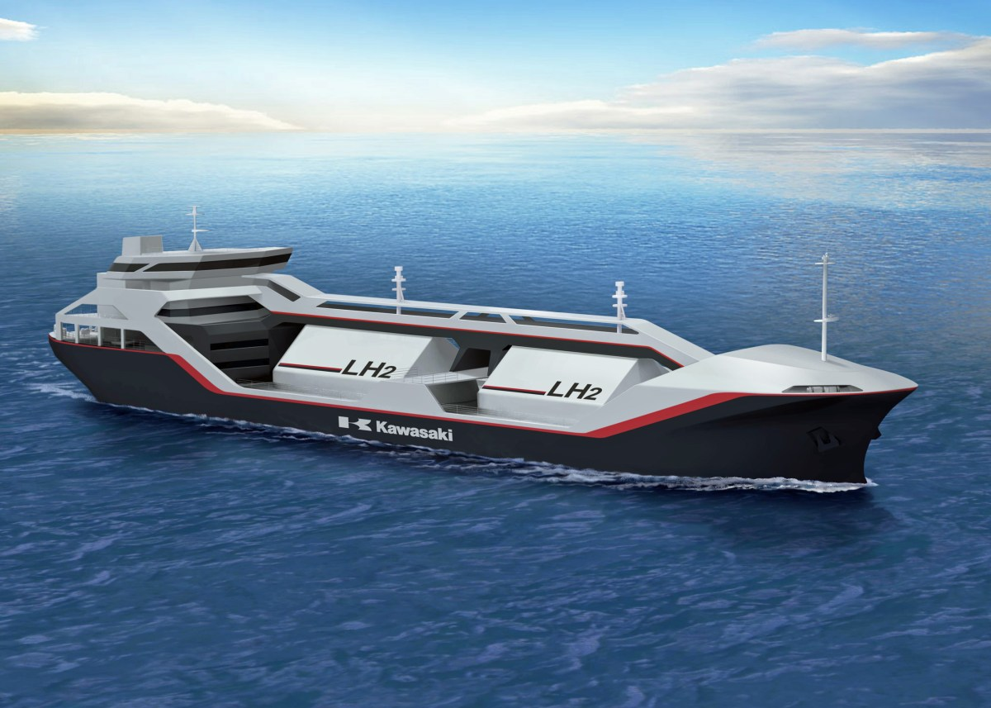



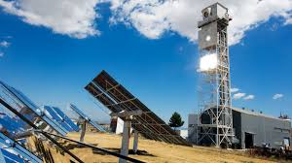
Fuel Cells operationeel
Fuel Cells operationeel
4000
500+
8000
16000
2000
1000
100 fuel station
7 cities, 200+
H2 plant

Slide 3
